Slide 1


Introduction to AWS in Supply Chain Management
Managing supply chains efficiently and effectively is crucial for businesses. Amazon Web Services (AWS) offers innovative solutions to streamline and optimize supply chain processes. From inventory management to logistics, AWS provides a comprehensive platform that can revolutionize the way companies handle their supply chain operations, leading to cost savings, improved visibility, and enhanced customer satisfaction.

Slide 2
Abstract:
This study explores the transformative impact of Amazon Web Services (AWS) in supply chain management through the implementation of track and trace systems. Leveraging AWS cloud infrastructure, the proposed solution integrates external data sources, processes data with AWS services, and employs a track and trace service for real-time monitoring. Data transformation ensures adaptability to diverse formats, while secure storage and notification mechanisms enhance visibility. The user interface, accessible through web or mobile applications, provides stakeholders with a centralized platform for tracking and tracing supply chain events. This integrated approach harnesses the power of AWS to optimize efficiency, transparency, and resilience in supply chain operations.

Slide 3
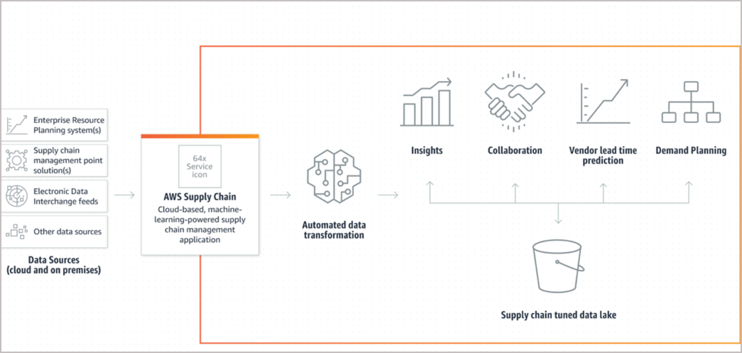

Slide 4
Overview of Track and Trace Systems
Real-time Monitoring
Data Analytics
Enhanced Visibility
Track and trace systems enable real-time monitoring of goods throughout the supply chain. This includes the ability to track the movement and location of packages at every stage of the journey.
These systems provide valuable data analytics, offering insights into delivery times, potential bottlenecks, and overall supply chain performance.
Enhanced visibility allows companies to optimize routes, manage inventory levels, and respond quickly to any disruptions or delays.

Slide 5
Benefits of Using AWS in Supply Chain Management
1
Scalability
2
Cost Efficiency
AWS offers scalable solutions, allowing businesses to adapt to changing demands and growth without the need for significant infrastructure investments.
By leveraging AWS, companies can reduce operational costs by paying only for the resources they use, avoiding upfront expenses on hardware and maintenance.
3
Reliability
4
Flexibility
AWS ensures high levels of reliability, with built-in redundancies and failover capabilities, minimizing the risk of disruptions in supply chain operations.
Businesses can flexibly customize and integrate various AWS services to meet specific supply chain requirements, enhancing operational efficiency.

Slide 6
Key Features of Track and Trace Systems
Real-time Monitoring
Data Analytics
Enhanced Visibility

Slide 7

Case Studies of Successful Implementation
Company A
Company B
Implemented AWS-driven track and trace system, resulting in 30% reduction in delivery times and 25% decrease in inventory carrying costs.
Enhanced supply chain transparency and accuracy, leading to 15% increase in order fulfillment rates and improved customer satisfaction.
Company C
Streamlined warehouse operations using track and trace technologies, resulting in 40% improvement in order processing efficiency.

Slide 8
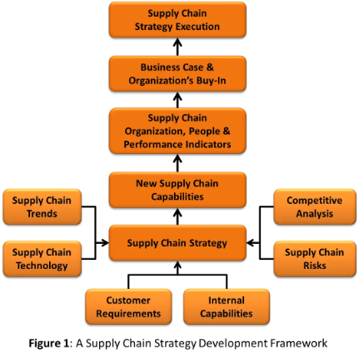
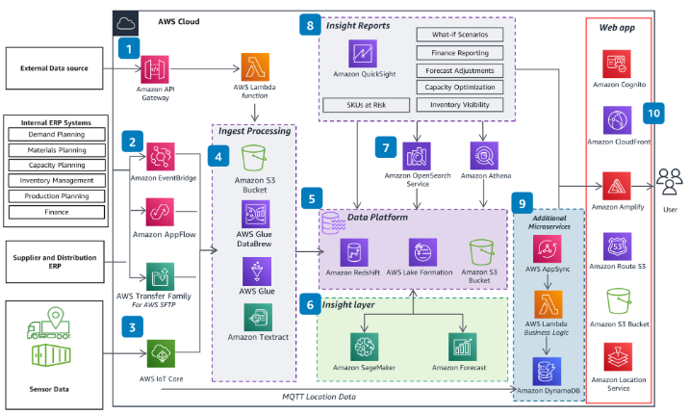

Slide 9
Challenges and Considerations in Adopting AWS for Track and Trace Systems
1
Data Security
2
Integration Complexities
3
Training and Adoption
Ensuring the security of sensitive supply chain data and protecting against cyber threats is a critical concern when adopting AWS in track and trace systems.
Integrating AWS solutions with existing supply chain infrastructure and software can pose challenges, requiring careful planning and expertise.
Companies need to invest in proper training and change management to ensure successful adoption and utilization of AWS-powered track and trace technologies.

Slide 10




Best Practices for Integrating AWS in Supply Chain Management
Assessment
Conduct a thorough evaluation of supply chain processes and IT infrastructure to identify opportunities and challenges for AWS integration.
Customization
Customize AWS solutions based on specific supply chain needs, considering factors such as order volume, distribution networks, and customer demand patterns.
Collaboration
Foster collaboration between supply chain and IT teams to ensure seamless integration, knowledge transfer, and alignment of strategic objectives.

Slide 11

Security and Data Privacy in Track and Trace Systems
Compliance Standards
Encryption Mechanisms
Adhere to industry-specific security standards and data privacy regulations to protect sensitive information within track and trace systems.
Implement robust encryption protocols to safeguard data integrity and confidentiality during information exchange across the supply chain network.
Access Control
Establish strict access controls and user permissions to prevent unauthorized access to critical supply chain data stored in track and trace systems.

Slide 12
Future Trends and Advancements in AWS for Supply Chain Management
1
AI-Powered Predictive Analytics
The integration of AI and machine learning in AWS will enable advanced predictive analytics for demand forecasting, inventory optimization, and supply chain risk management.
2
IoT-enabled Supply Chain Visibility
Expanding use of IoT devices and sensors, integrated with AWS, will enhance real-time visibility and tracking capabilities across the supply chain network.
3
Blockchain for Transparency
Blockchain technology will be increasingly leveraged within AWS to ensure transparency, traceability, and authenticity of transactions and data in supply chain operations.

Slide 13
Conclusion and Key Takeaways
3
82%
5M
Efficiency
Adoption Rate
Global Impact
AWS integration in supply chain management can lead to a 30% increase in operational efficiency and cost savings.
Over 82% of businesses report successful adoption and positive impact from incorporating AWS in their supply chain processes.
The use of AWS-powered track and trace systems has impacted over 5 million supply chain transactions worldwide, enhancing visibility and performance.

